Slide 1
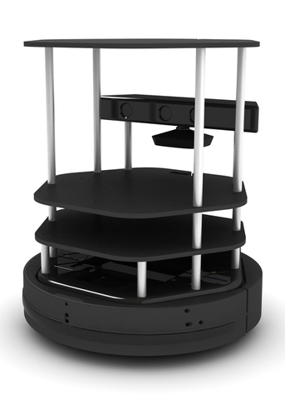

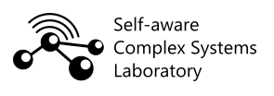
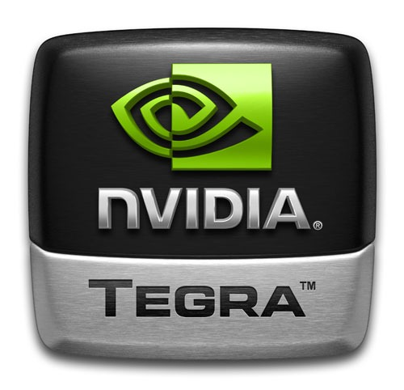
ME 592X
Assignment 4
Robotics

Slide 2

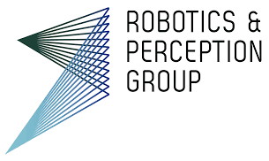
Introduction
Goal
Implement imitation learning algorithm into Turtlebot
Dataset
Steering angle - Udacity Self-Driving Car Repository
Collision - ETZ Zurich Robotics & Perception Group
Model
Mini-MobileNet

Slide 3
Data Preprocessing
Collision dataset - preprocessed
Steering angle dataset - rosbag files
Udacity-driving-reader - camera and steering_angle.csv
Timestamp matching - images and labels.txt

Slide 4
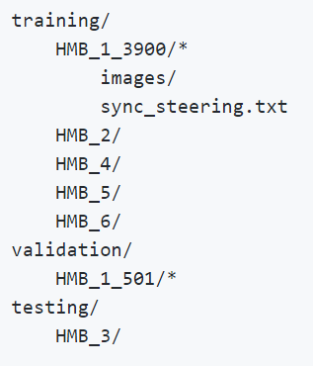
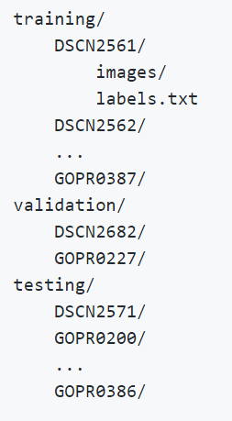
Data Preprocessing
Steering data
Collision data

Slide 5
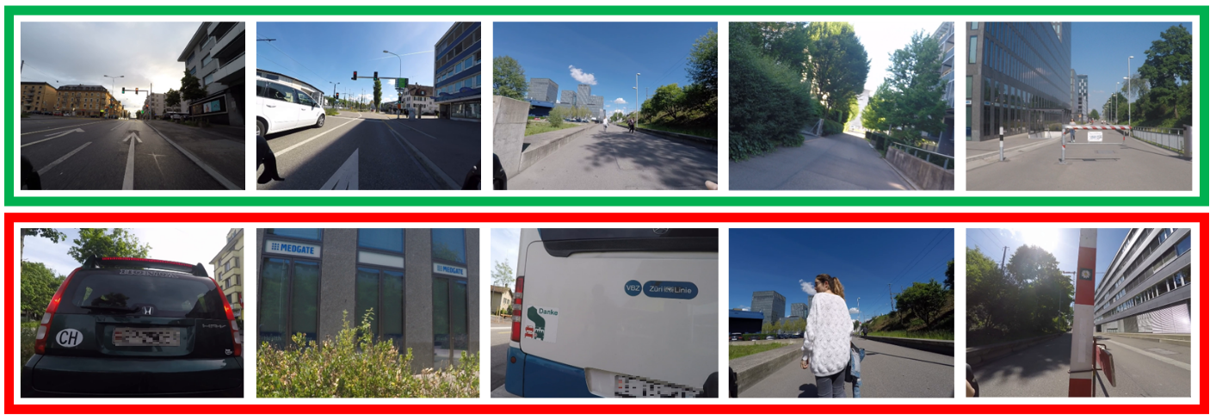
Data Images (Collision Probability)

Slide 6
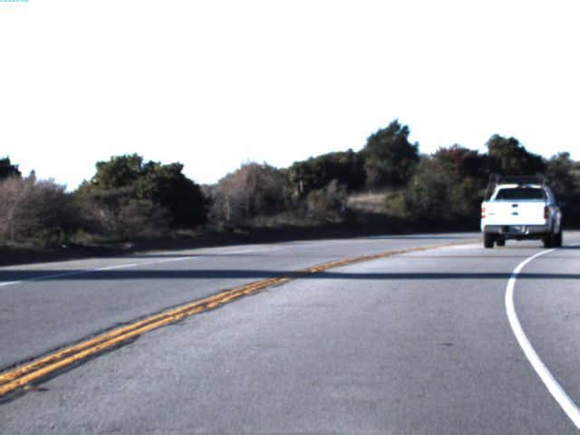
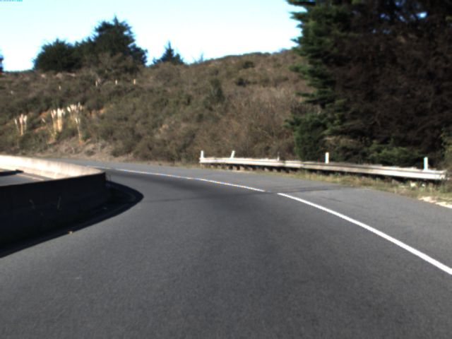
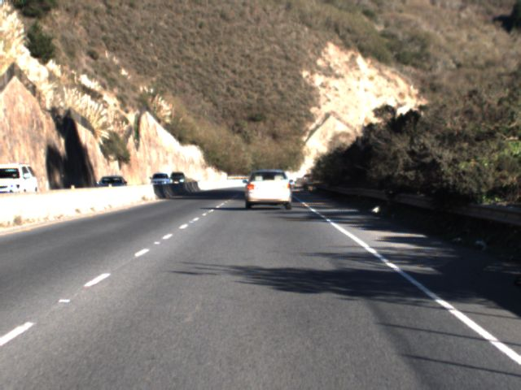
Data Images (Steering Angle, rad.)
Steering Angle: - 0.244
Steering Angle: 0.919
Steering Angle: 0.0068

Slide 7
MobileNet Network Architecture
The MobileNet model is based on depthwise separable convolutions which is a form of factorized convolutions that factorize a standard convolution into a depthwise convolution and a 1 X 1 convolution called pointwise convolution.
The depthwise separable convolution splits a standard convolution layer into two layers, one for filtering and a separable layer for combining
MobileNet uses 3 X 3 depthwise separable convolutions which drastically reduces computation at only a small reduction in accuracy
All layers inside a MobileNet block is followed by a batchnorm and ReLU non linearity
Downsampling is handled by strided convolutions
The width (alpha) multiplier reduces the computational cost and number of parameters. It reduces size, latency whilst giving a reasonable accuracy.

Slide 8
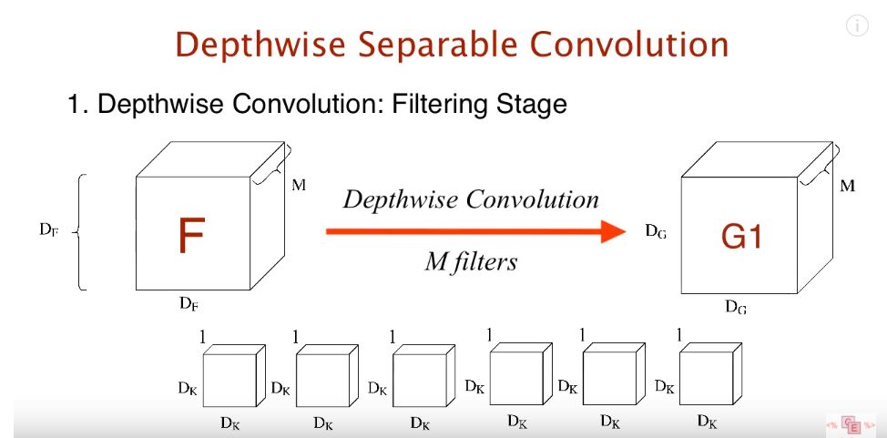
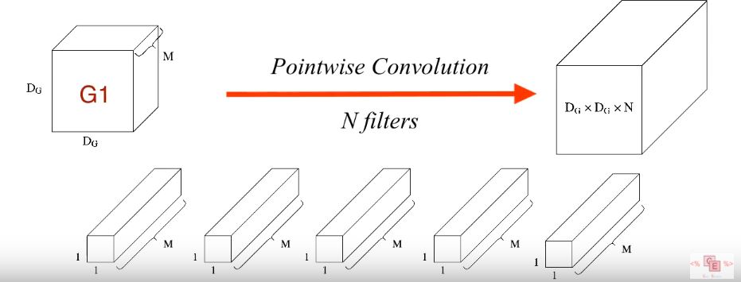
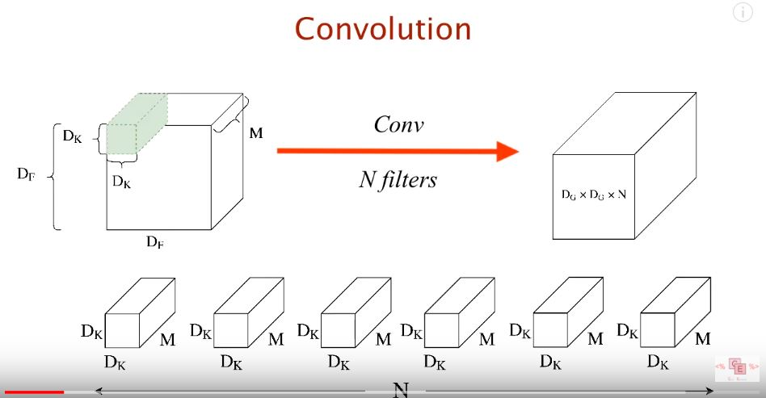
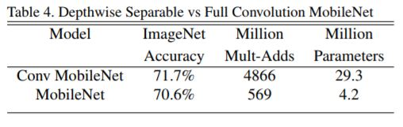
Standard convolution vs Depthwise and pointwise convolution

Slide 9
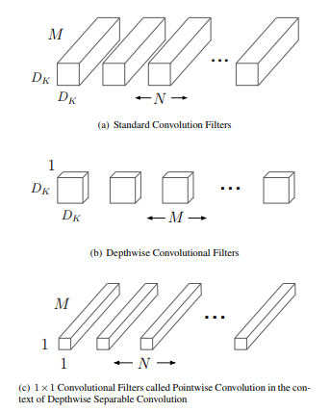


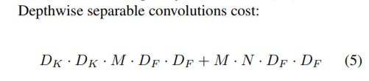
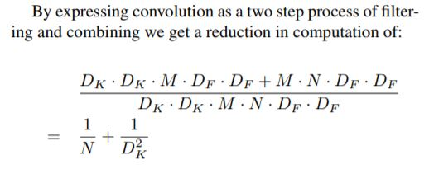
Depthwise and pointwise convolution

Slide 10
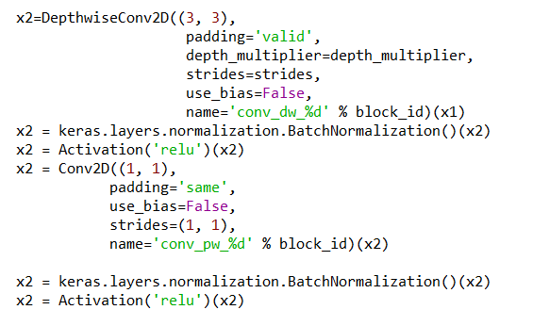
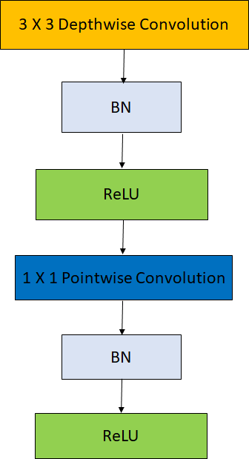
MobileNet Block

Slide 11
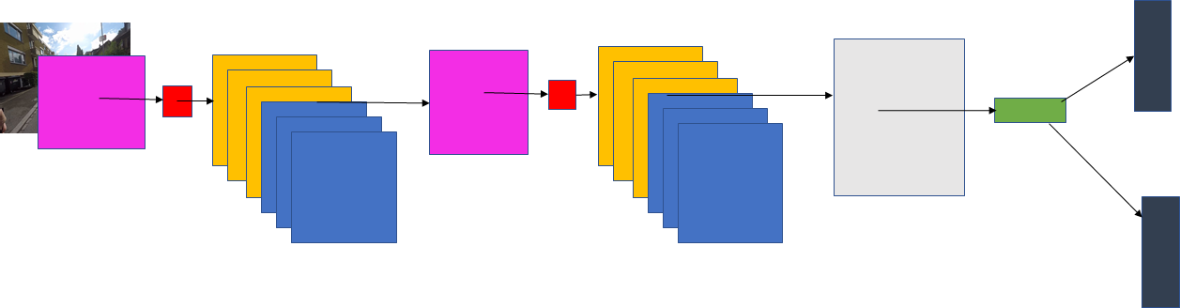
TBot-Net Architecture
200 X 200 Input Image
3 X 3
Max Pool
3 X 3
Max Pool
Steering angle
ReLU
Collision Prob
5 X 5 Conv
5 X 5 Conv
Dropout
MobileNet Block
MobileNet Block

Slide 12
Different Architectures Tested
 | Epoch | Batch Size | Mode | Number of fiter (Conv1, Conv2) | Comments | Optimizer
Run 1 | 100 | 32 | Greyscale | 32 - 64 | 1 MobileNet module | Adam
Run 2 | 50 | 64 | RGB | 32 - 64 | 1 MobileNet module | Adam
Run 3 | 50 | 32 | RGB | 32 - 64 | Additional MaxPooling and depthwise after 2nd convolution layer | Adam
Run 4 | 20 | 32 | Greyscale | 16 - 32 | 1 MobileNet module | Adam
Run 5 | 50 | 128 | RGB | 32- 64 | Additional MaxPooling and depthwise after 2nd convolution layer | SGD
Run6 | 50 | 128 | RGB | 32 - 64 | 2 MobileNet modules | SGD

Slide 13
Loss Functions
Hard-Mining Mean Square Error Steering Angles
Hard Mining Cross Entropy Loss for Collision Probability
Reduces number of false positives in dataset across training epochs

Slide 14
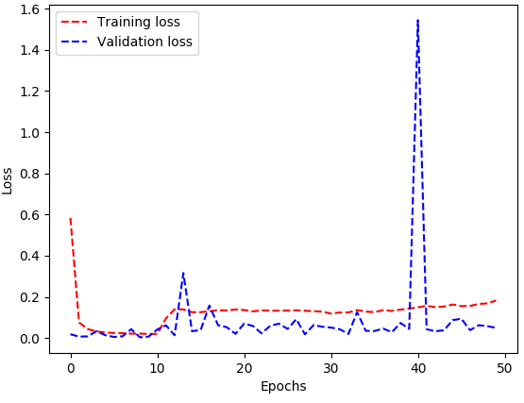
Training results

Slide 15
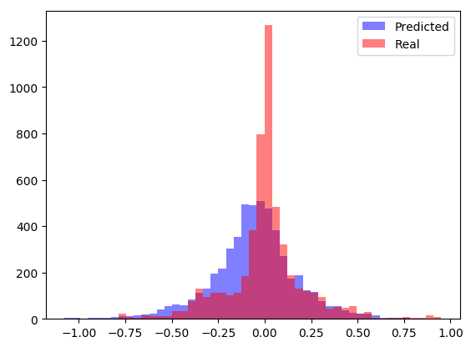
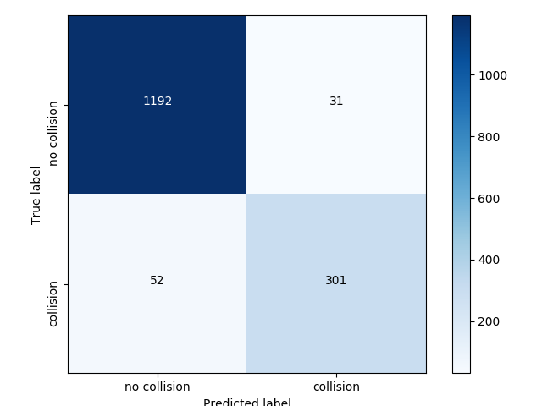
Training Results
Use plot_results.py on json file after running evaluation
PREDICTED LABEL

Slide 16
Training Results
Steering angle | Explained Variance(EVA) | 0.369
 | RMSE | 0.180
Collision | Accuracy | 0.947
 | Precision | 0.907
 | Recall | 0.853
 | F1-Score | 0.879

Slide 17
TurtleBot Implementation
A mobile base equipped with a RGB-D camera, 3D distance sensor, a NVIDIA Tegra K1 processor, and the TurtleBot mounting hardware kit
Tegra K1 runs on Ubuntu 14.04.2
Proposed Pipeline:
Install Keras and Tensorflow on Turtlebot
Use Turtlebot’s live feed camera as input to MobileNet
Use ROS packages to convert camera live feed in still images
Run inference on images using trained model and weights
Connect predicted steering angles to TurtleBot’s steering commands
Connect predicted collision probability to TurtleBot’s speed commands
Monitor TurtleBot’s performance remotely

Slide 18
Challenges
Reinstallation of Ubuntu and ROS on Turtlebot
Connecting to the Turtlebot remotely
Different versions of Keras and Tensorflow implemented for MobileNet
Extracting images from Rosbags

Slide 19
References
http://rpg.ifi.uzh.ch/dronet.html
https://github.com/udacity/self-driving-car/tree/master/datasets/CH2
https://arxiv.org/abs/1704.04861v1
https://github.com/keras-team/keras/blob/master/keras/applications/mobilenet.py

